Slide 1
  NAGIOS

Slide 2
WHERE DOES NAGIOS FIT?
Nagios, in some ways, ties it all together. We've seen things like:
  SNMP
  MRTG
  RRDTool
  Rancid
  Cacti
  Smokeping
You can and will use all this functionality in Nagios.
It is a monolithic tool:
Big
Complex
Powerful

Slide 3
WHY NAGIOS
Open source
Relatively scalable, Manageable, Secure and more
Best documentation available
Good log and database system
Nice, informative and attractive web interface
Very flexible
Alerts automatically sent if condition changes
Various notification options (Email, pager, mobile phone)‏

Slide 4
WHY NAGIOS
Avoidance of “Too many red flashing lights”
“Just the facts” – only want root cause failures to be reported, not cascade of every downstream failure.
also avoids unnecessary checks
e.g. HTTP responds, therefore no need to ping
e.g. power outage, no ping response, so don’t bother trying anything else
Services are running fine no need to do check if the host itself is alive

Slide 5
WHAT CAN IT DO?
  Individual node status
  Is it up?
  What is its load?
  What is the memory and swap usage?
  NFS and network load?
  Are the partitions full?
  Are applications and services running properly?
  How about ping latency?
  Aggregated node status
  Same info, but across groups of nodes

Slide 6
WHAT CAN IT DO?
A lot, including:
Service monitoring
Alerts from SNMP traps
Monitoring redundancy
Detection of primary failure to avoid multiple like alerts.
Notifications via email, pager, etc.
Notifications to individuals or defined groups
Log information
Use databases to store history
Graph generation from MRTG
Very extensible via plug-ins, add-ons and local scripts.
Can scale to large installations
Allows for redundant monitoring
Aggregation of like-data across multiple nodes.
Ability to escalate alerts
Runs on multiple Unices
Licensed under GPL v2

Slide 7








Sample Setup
Check memory
Check disk
Check load
Check ping
Check host alive
Check dns
Check bandwidth
Check ping
Gateway
Gateway
Web UI
Web Client At NOC
Web Client At NO

Slide 8
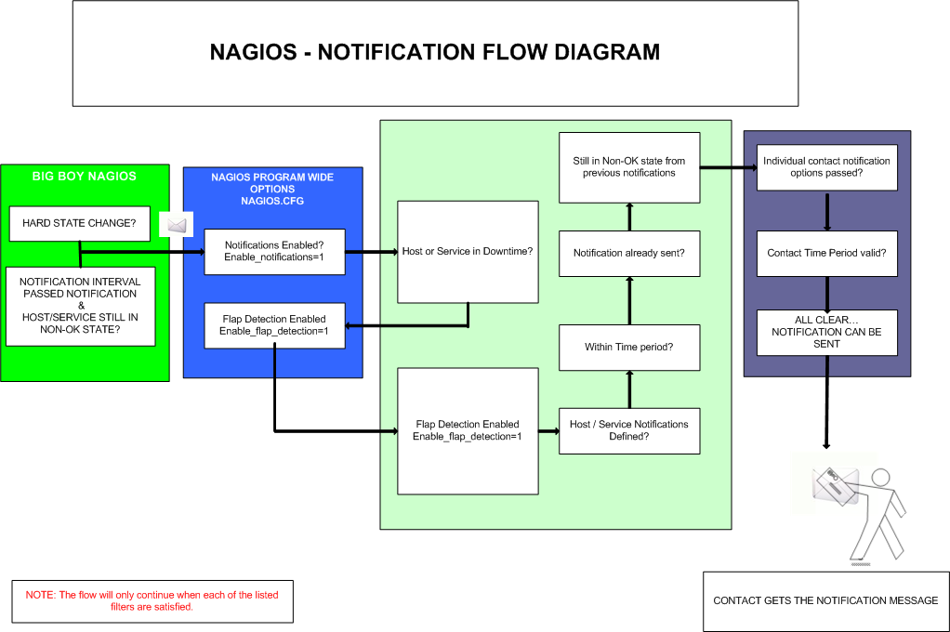

Slide 9
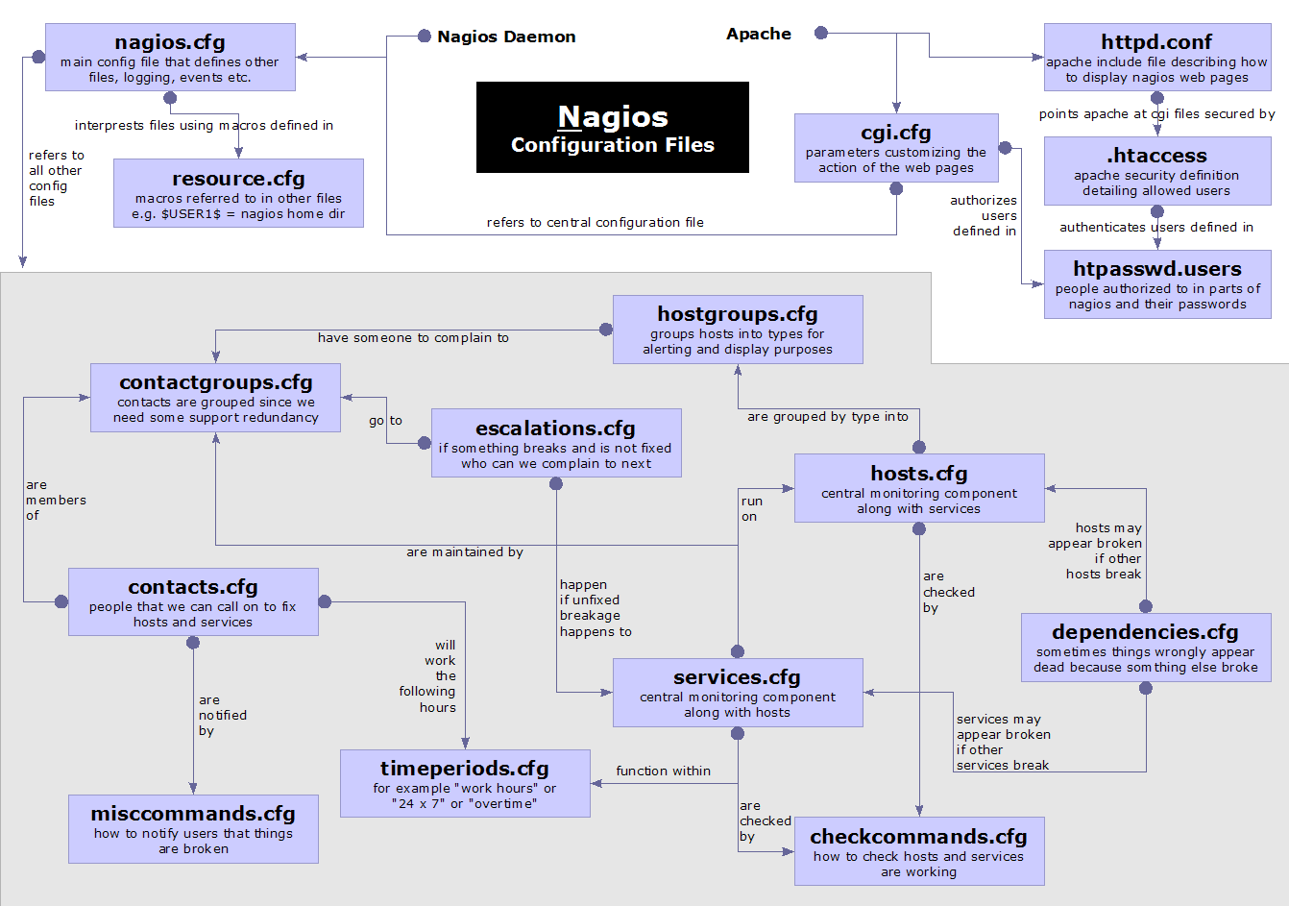
NAGIOS CONFIGURATION

Slide 10
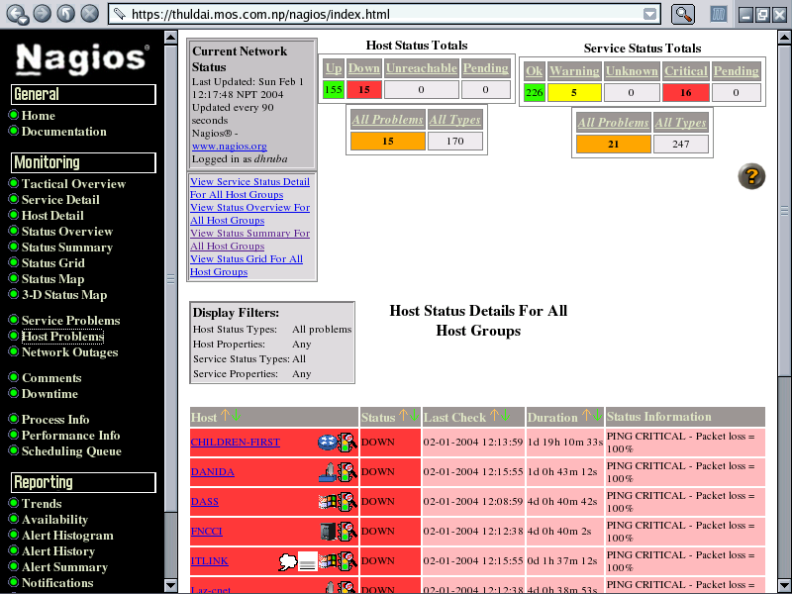
  Nagios Status Detail screen

Slide 11
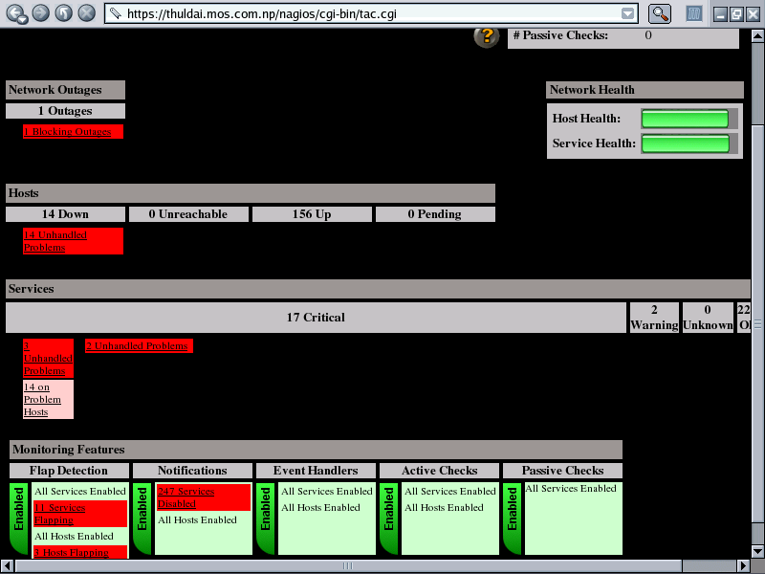
Tactical Overview Of Nagios

Slide 12
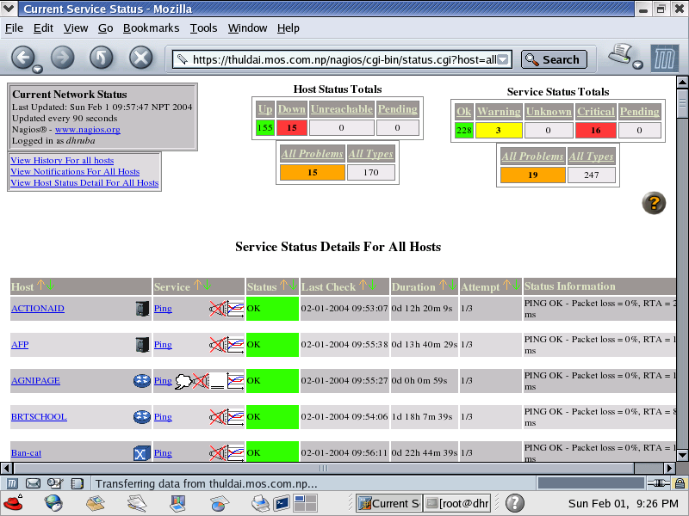
Service Detail of Nagios

Slide 13
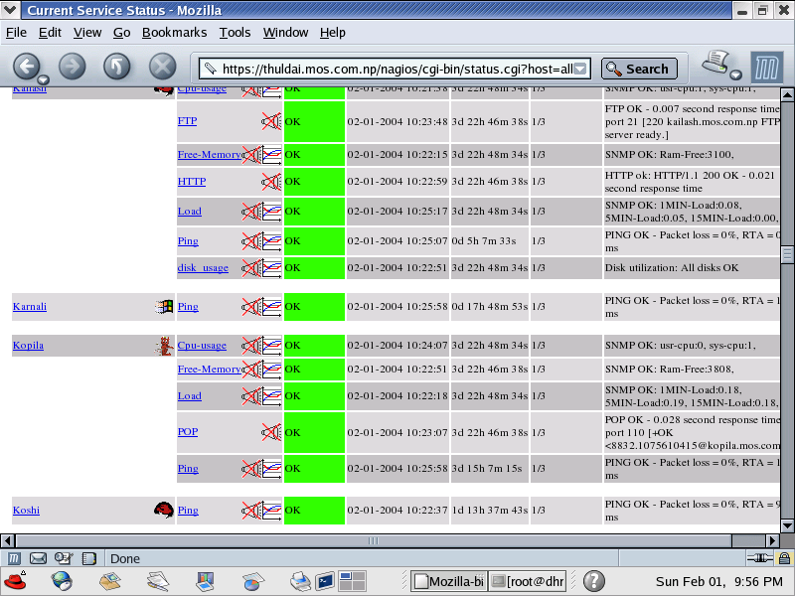
Service Types

Slide 14
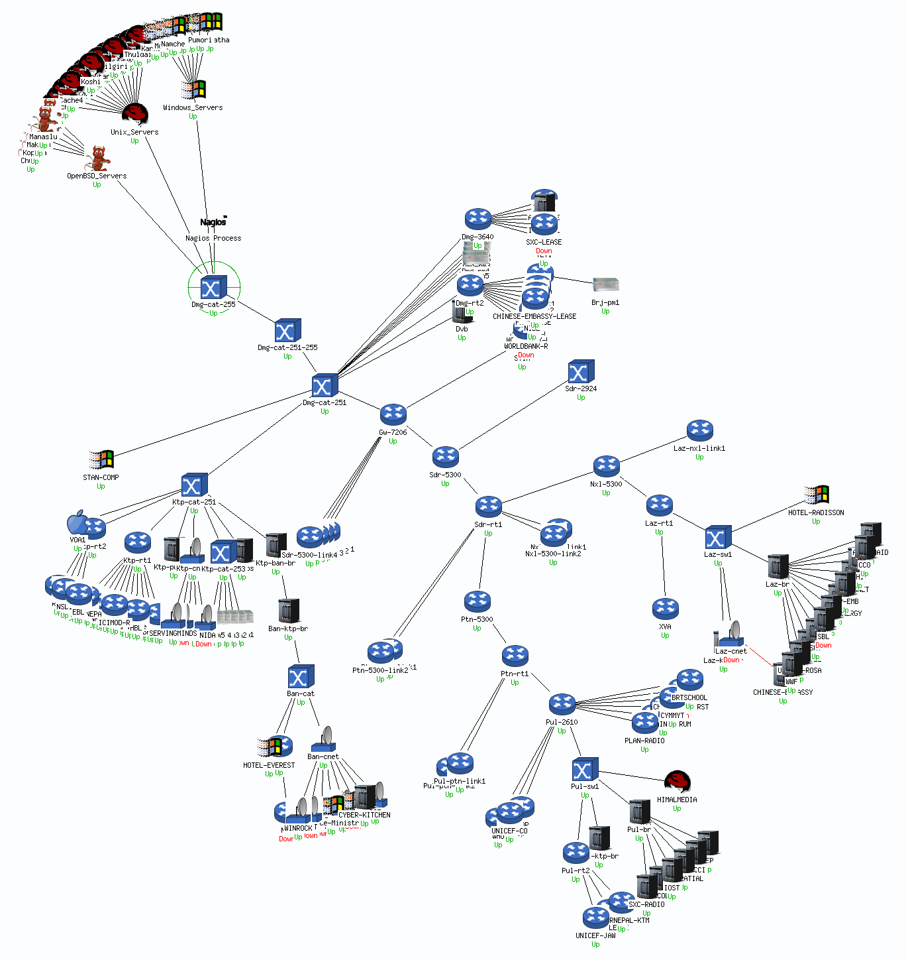
Status Map of MC Network From Nagios

Slide 15
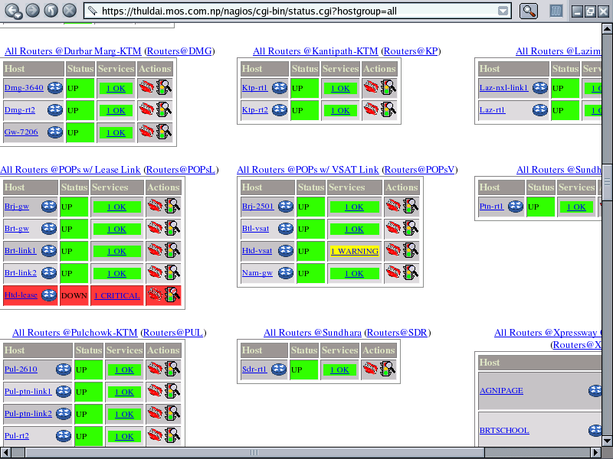
Status Overview from nagios

Slide 16
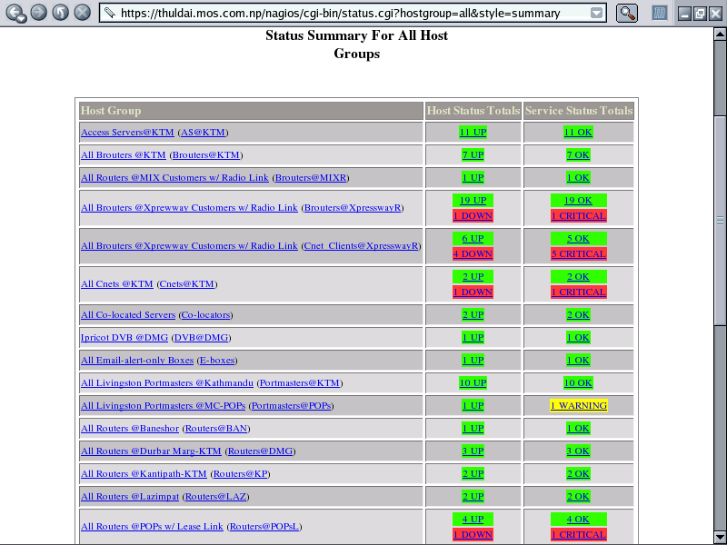
Status Summary Based On Hostgroup

Slide 17
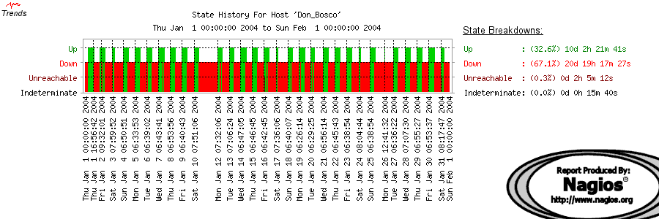
Host Trends or Status History

Slide 18
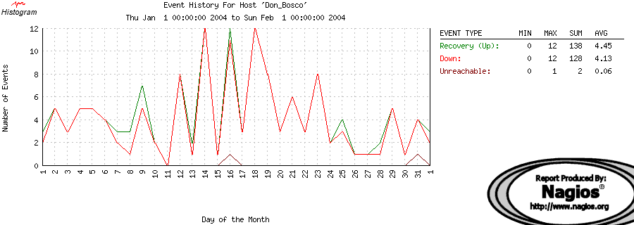
Histogram Of Host

Slide 19
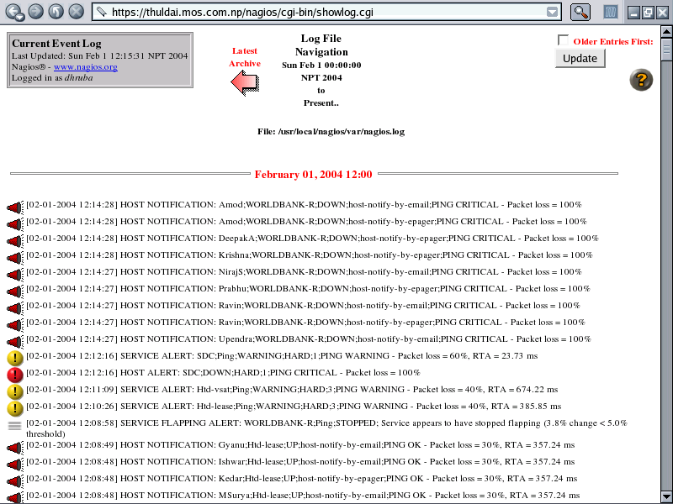
Event Logs

Slide 20
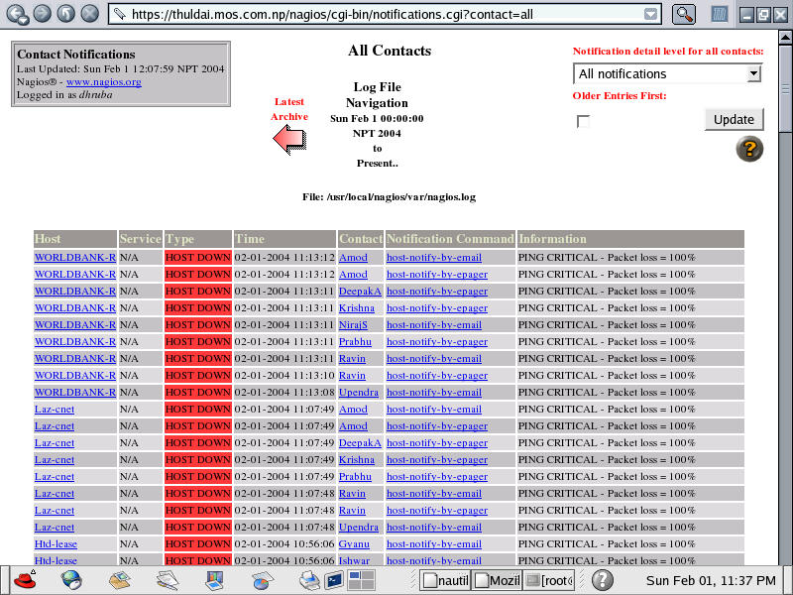
Who is Notified?

Slide 21
Notification Email Sample
From: nagios@thuldai.mos.com.np
To: "ishwars@mos.com.np" <ishwars@mos.com.np>
Subject: Host DOWN alert for WORLDBANK-L!
Date: 05/02/04 11:09
***** Nagios *****
Notification Type: PROBLEM
Host: WORLDBANK-L
State: DOWN
Address: 202.52.239.70
Info: PING CRITICAL - Packet loss = 100%
Date/Time: Thu Feb 5 11:06:38 NPT 2004

Slide 22
NAGIOS CONFIGURATION FILES
Located in /etc/nagios2/
Important files:
  cgi.cfg controls the Web Interface
  options security
  commands.cfg commands that Nagios
  uses to notify
  nagios.cfg main Nagios configuration file
  conf.d/* the core of the config files

Slide 23
NAGIOS CONFIGURATION FILES
Under conf.d/*, files “xxxx_nagios2.cfg”:
contacts users and groups
generic-host “template” host (default)‏
generic-service “template” service
hostgroups host group definitions
services which services to check
timeperiods when to check and notify

Slide 24
NAGIOS PLUGIN CONFIGURATION
/etc/nagios-plugins/config/
apt.cfg ntp.cfg dhcp.cfg ping.cfg
disk.cfg procs.cfg dummy.cfg real.cfg
ftp.cfg ssh.cfg http.cfg tcp_udp.cfg
load.cfg telnet.cfg mail.cfg users.cfg
news.cfg

Slide 25
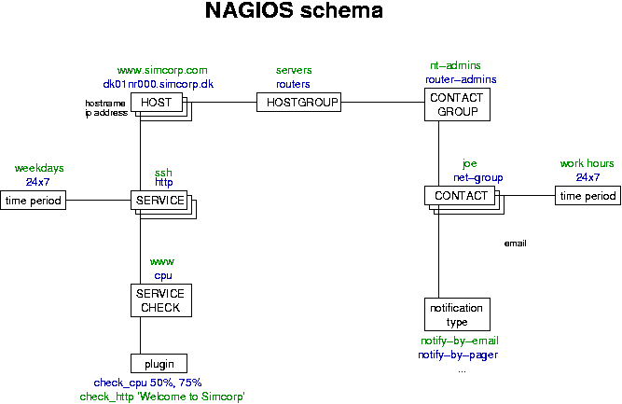

Slide 26
CONCEPTS: PARENTS
Hosts can have parents
  Allows one to specify which dependencies there are in the network
  Avoid sending alarms if we cannot know the state of a host...

Slide 27
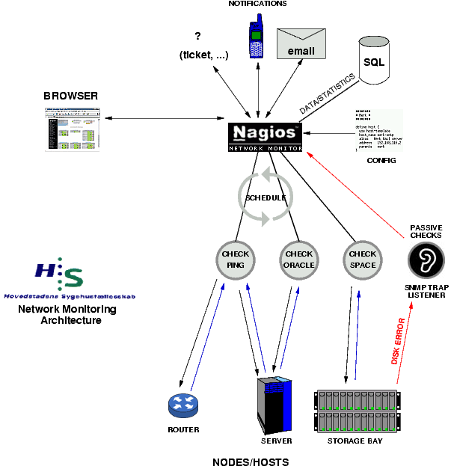

Slide 28
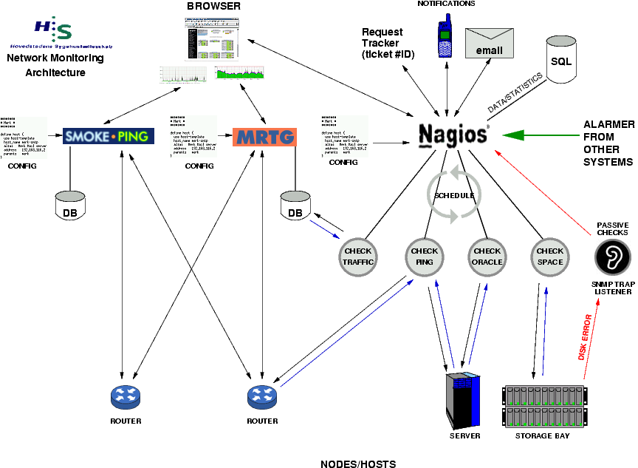
NAGIOS – WORKING PRINCIPLES

Slide 29
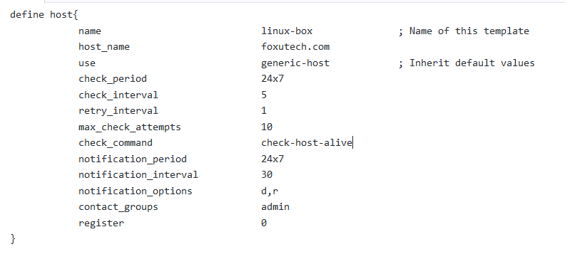
HOST CONFIG

Slide 30
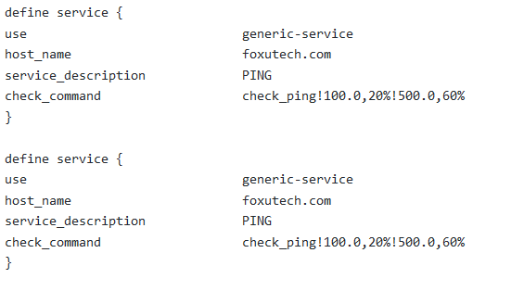
SERVICE CONFIG

Slide 31
NAGIOS RESOURCES
Nagios Home
http://www.nagios.org/
Nagios Plugins and Add Ons Exchange
http://www.nagiosexchange.com/
Nagios Tutorial for Debian
http://www.debianhelp.co.uk/nagios.htm
Nagios Commercial Support
http://www.nagios.com/

